Slide 1

Developing Management Skills
Chapter 8:
Empowering and Delegating

Slide 2
Learning Objectives
Develop and execute plans to empower others
Proactively adopt principles of personal empowerment
Utilize principles of effective delegation

Slide 3

Empowerment
Providing freedom for people to do what they want to do (pull), rather than getting them to do what you them to do (push).

Slide 4

Results of Empowerment
Empowered employees are more productive and happier; empowerment also helps the organization stay flexible and adapt to changes.

Slide 5

A Dilemma
While empowerment is a positive for organizations, managers often feel threatened by it and perceive it as a loss of their own power.

Slide 6
The Dirty Dozen of Stress
Centralization
Threat-rigidity response
Loss of innovation
Decreasing morale
Politicized environment
Loss of trust
Increased conflict
Restricted communication
Lack of teamwork
Loss of loyalty
Scapegoat leaders
Short-term perspective

Slide 7
Empowerment
Helps develop self-confidence
Helps overcome feelings of powerlessness
Energizes people to take action
Creates intrinsic motivation

Slide 8

Lack of Empowerment
Negative Consequences
  Powerlessness
  Helplessness
  Alienation

Slide 9
The Differences Between Power and Empowerment
Power
  External Source
  Few have it
  The capacity to have others do what you want
  To get more implies taking it away from someone else
  Leads to competition
Empowerment
  Internal Source
  Ultimately, everyone can have it
  The capacity to have others do what they want
  To get more does not affect how much others have
  Leads to cooperation

Slide 10

5 Dimensions of Empowerment
Self-efficacy
Self-determination
Personal consequences
Meaningfulness
Trust

Slide 11
Self-Efficacy
A sense of personal competence
  Belief that I have the ability to perform the task
  No outside obstacles will prevent me from accomplishing the task

Slide 12
Self-determination
A sense of personal choice
  about the methods I use
  about the effort I will expend
  about the pace of the work
  about the time frame

Slide 13
Personal consequences
Sense of having impact
  Active control – I can bring the environment into alignment with my wishes (instead of vice-versa)
  Accountability – I am responsible for my own outcomes

Slide 14
Meaningfulness
Sense of value in the activity
  I value the purpose/goals of the activity
  Methods align with my value system
  Gives me a personal sense of purpose, passion, or mission

Slide 15
Trust
Sense of security
  I will be treated fairly and equitably
  I feel comfortable developing relationships
  I can act in a confident and straightforward manner

Slide 16

Developing Empowerment
Articulate a clear vision
Provide opportunities to foster personal mastery
Model the correct behavior
Provide support
Create emotional arousal
Provide necessary information
Provide necessary resources
Connect to outcomes
Create confidence

Slide 17

“SMART” Goals
Specific
Measurable
Aligned
Realistic
Time-bound

Slide 18

Five Factors to Create Confidence
Reliability
Fairness
Caring
Openness
Competence

Slide 19
Articulate a Clear Vision and Goals
Create a picture of a desired future
Use word pictures and emotional pictures to describe vision
Identify actions that will lead to a vision
Establish SMART goals
Associate the vision with personal values

Slide 20
Foster Personal Mastery Experiences
Break apart large tasks and assign one at a time
Assign simple tasks before difficult ones
Highlight and celebrate small wins
Incrementally expand job responsibilities
Give increasingly more responsibilities to solve problems

Slide 21
Model Successful Behaviors
Demonstrate successful task accomplishment
Point out other people who have succeeded
Facilitate interaction with other role models
Find a coach
Establish a mentor relationship

Slide 22
Provide Support
Praise, encourage, express approval for and reassure
Send letters or notes of praise to family members or coworkers
Foster informal social activities to build cohesion
Supervise less closely and provide time-slack
Hold recognition ceremonies

Slide 23
Arouse Positive Emotions
Foster activities to encourage friendship formation
Periodically send light-hearted messages
Use superlatives in giving feedback
Highlight compatibility between important personal values and organizational goals
Clarify impact on the ultimate customer
Foster attributes of recreation in work

Slide 24
Provide Information
Provide all task relevant information
Continuously provide technical information
Pass along relevant cross-functional information
Provide access to people with senior responsibility
Provide access to information from its source
Clarify effects of actions on customers

Slide 25
Provide Resources
Provide training and development experiences
Provide technical support
Provide needed time, space, or equipment
Ensure access to relevant information networks
Provide more discretion to commit resources

Slide 26
Connect to Outcomes
Provide a chance to interact directly with those receiving the service
Provide authority to resolve problems on the spot
Provide immediate, unfiltered, direct feedback
Create task identity
Clarify and measure effects

Slide 27
Create Confidence
Exhibit reliability and consistency
Exhibit fairness and equity
Exhibit caring and personal concern
Exhibit openness and honesty
Exhibit competence and expertise

Slide 28

Inhibitors to Empowerment
Attitudes about subordinates
Personal insecurities
Need for control

Slide 29
Advantages of Delegation
Increase discretionary time for manager
Develops employee knowledge
Demonstrates trust
Enhances commitment

Slide 30
Advantages of Delegation
Improves decision making
Enhances efficiency of decisions
Fosters work integration by manager coordination

Slide 31
Delegating
Things to consider when delegating:
Qualifications of subordinate
Necessity of employee commitment
Expansion of employee capabilities
Evidence of shared values and perspectives
Sufficient time for delegation

Slide 32
Guidelines for Effective Delegation
Begin with the end in mind
Delegate completely
Allow participation
Establish parity between authority and responsibility
Work with the organizational structure

Slide 33
Guidelines for Effective Delegation
Provide adequate support
Focus accountability on results
Delegate consistently
Avoid upward delegation
Clarify consequences

Slide 34
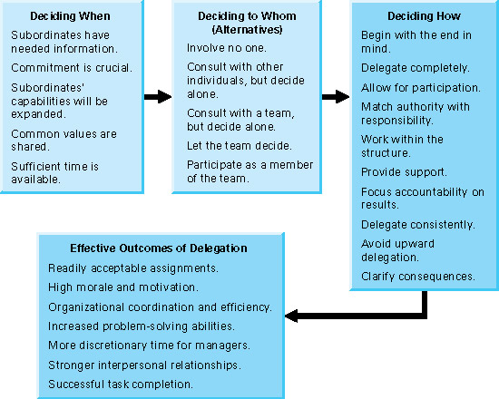
Principles of Effective Delegation
Insert figure 8.3

Slide 35
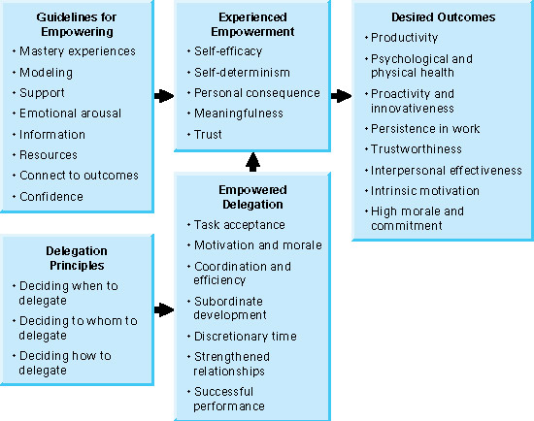
Relationships Among Empowerment and Empowered Delegation
Insert figure 8.4

Slide 36
Behavioral Guidelines
Foster self-efficacy through personal mastery experiences
Foster self-determination by providing alternatives
Foster personal consequences by helping people see the outcomes of their work
Foster meaningfulness by clarifying vision

Slide 37
Behavioral Guidelines
Foster trust by being consistent, honest, open, and fair
Delegate work effectively

Slide 38

All rights reserved. No part of this publication may be reproduced, stored in a retrieval system, or transmitted, in any form or by any means, electronic, mechanical, photocopying, recording, or otherwise, without the prior written permission of the publisher. Printed in the United States of America.
Copyright ©2011 Pearson Education

